Slide 1
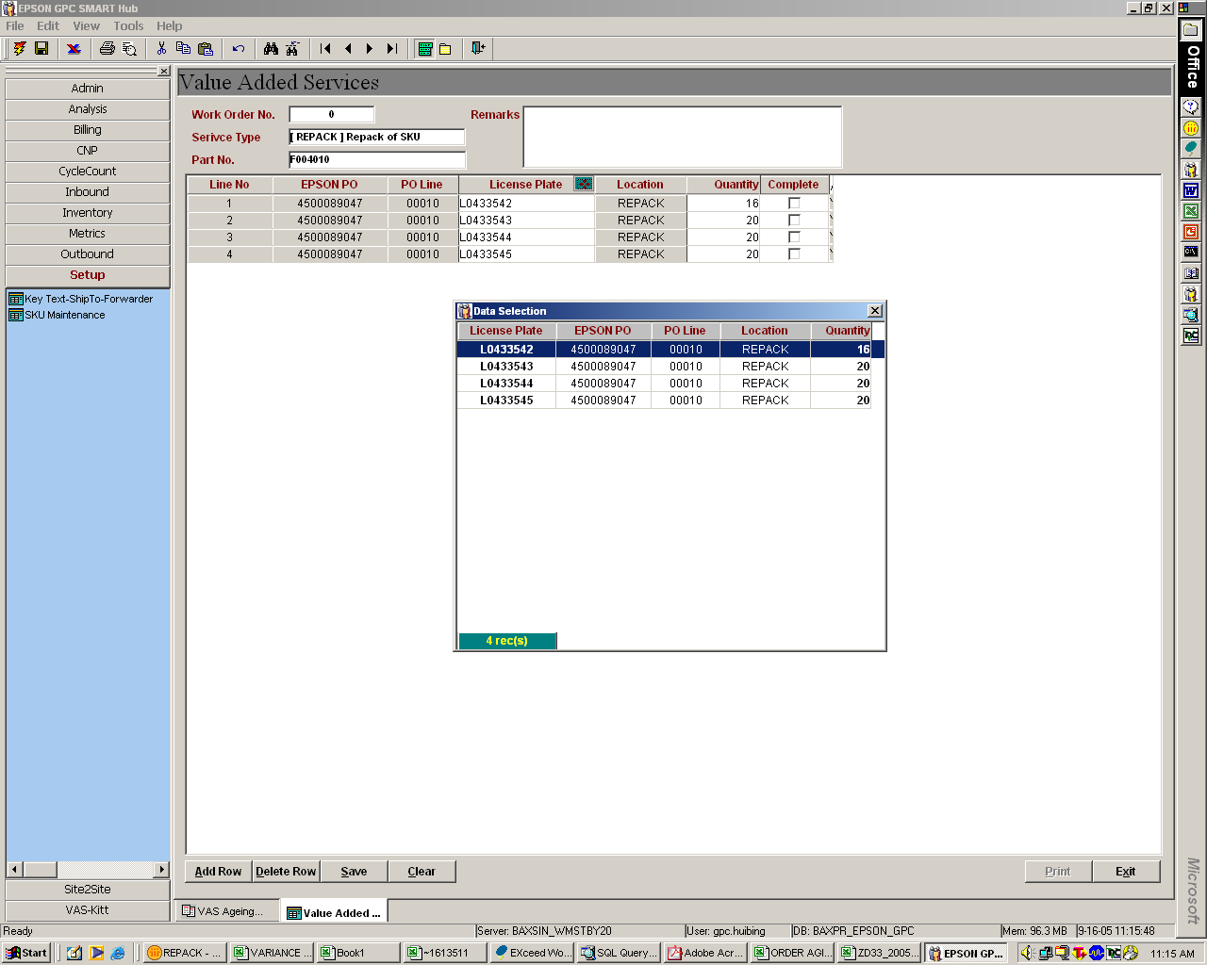
Drop down Invoice No/ COO for Auto-Add
filter criteria.
Invoice# / COO
Auto-add
Step 2:
Functions remain as per status quo for ad-hoc partial amendment
Step 1:
Key in Part No. then Tab and show drop down Invoice No. /Coo Menu
Click “Auto-add” button -> all inventory in ‘REPACK’ location for the Part No. and exists in selected Invoice No will auto-add to detail.
Double Click to activate “auto-add” function for existing work orders.
Allow user to auto-add multiple Invoice nos provide COO is unique
Error prompt for non-unique COO
To minimize user manual data selection
Step 2:
Functions remain as per status quo for ad-hoc partial amendment

Slide 2
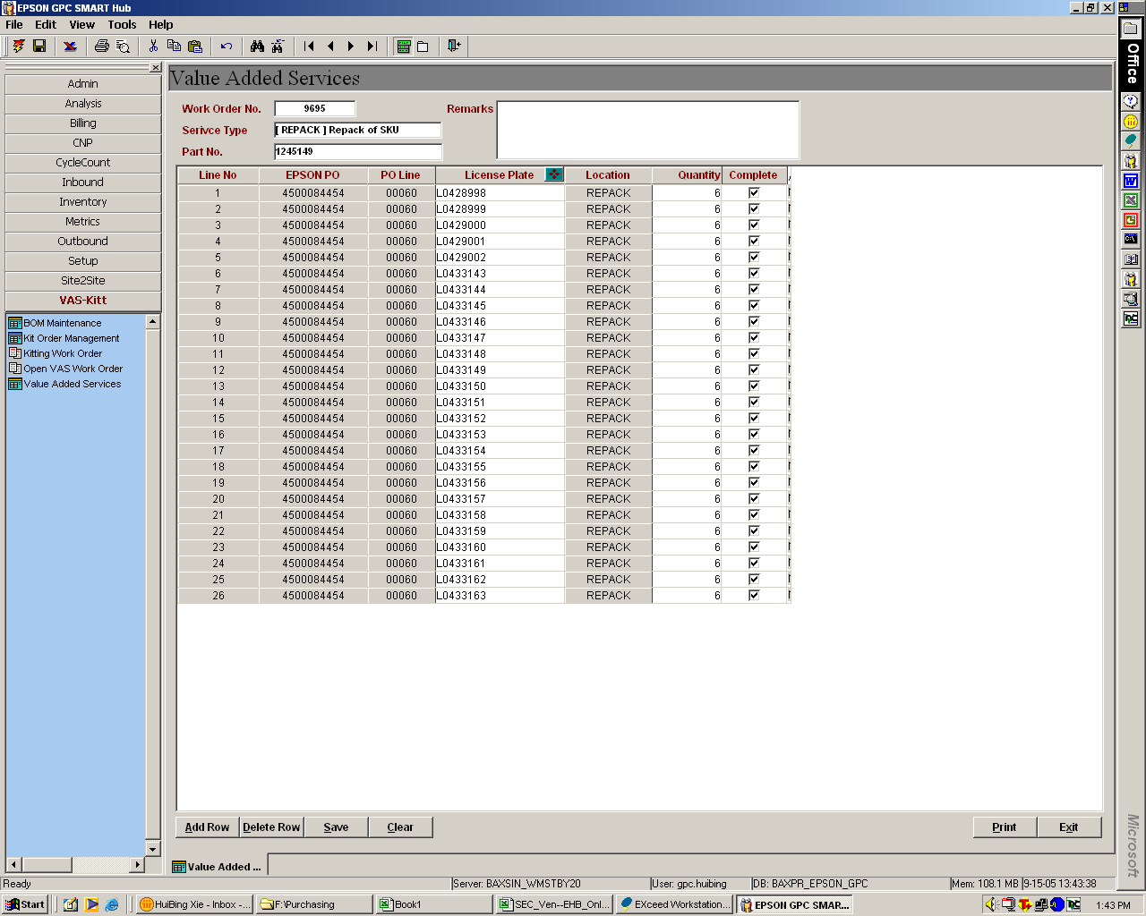
Allow user to uncheck any box
Include a “Check All” icon which checks all boxes upon clicking

